Slide 1
DATA 468: Applied Stochastic Process
by
Dr. Zakir
Department of Mathematics University of Arizona
Email: zakir@arizona.edu

Slide 2
Outline
Classification of States
Accessible
Communicate
Irreducible
Recurrence & Transience
Periodicity
Supplementary readings
3
4
Notes:
https://www.probabilitycourse.com/chapter11/11_2_4_classification_of_states.php
https://galton.uchicago.edu/~yibi/teaching/stat317/2021/Lectures/Lecture3.pdf

Slide 3
Outline
Classification of States
Accessible
Communicate
Recurrence & Transience
Irreducible
Periodicity
Supplementary readings
3
4
Notes:
https://www.probabilitycourse.com/chapter11/11_2_4_classification_of_states.php
https://galton.uchicago.edu/~yibi/teaching/stat317/2021/Lectures/Lecture3.pdf
https://www.youtube.com/watch?v=mi_IdLWomSU

Slide 4
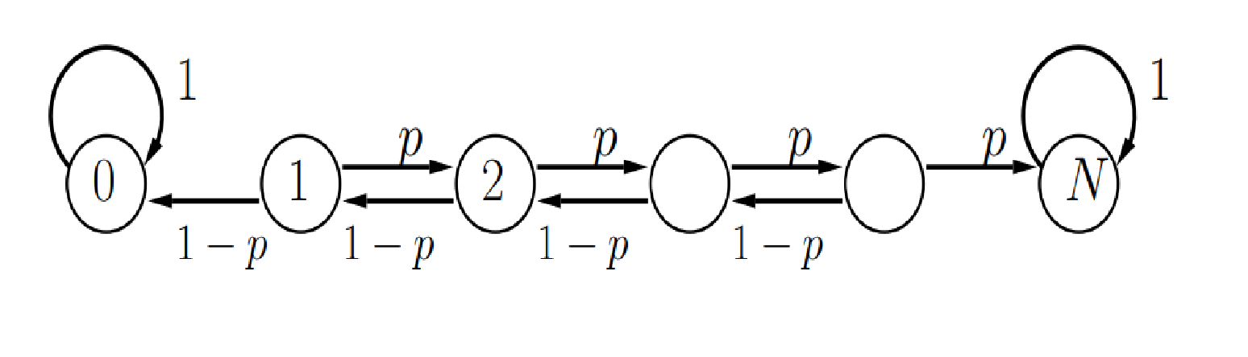
Accessible
If it is possible to go from state i to state j, we say that state j is accessible from i.
Alternatively, state j is accessible from state i, written as i→j, if for some n.
We assume every state is accessible from itself since
When there is an arrow from state i to state j, then
State 0 is accessible from any state 0 < i < N, but not the other way.
Notes:
https://www.sjsu.edu/faculty/guangliang.chen/Math263/lec3classification.pdf
https://www.probabilitycourse.com/chapter11/11_2_4_classification_of_states.php

Slide 5
Outline
Classification of States
Accessible
Communicate
Recurrence & Transience
Irreducible
Periodicity
Supplementary readings
3
4
Notes:
https://www.probabilitycourse.com/chapter11/11_2_4_classification_of_states.php
https://galton.uchicago.edu/~yibi/teaching/stat317/2021/Lectures/Lecture3.pdf
https://www.youtube.com/watch?v=mi_IdLWomSU

Slide 6
Communicate
Two states i and j are said to communicate if they are accessible from each other.
state i,j communicates if it's possible to go from i to j and from j to i with positive probability in some finite number of steps.
States 1 to N −1 communicate.
Notes:
https://www.sjsu.edu/faculty/guangliang.chen/Math263/lec3classification.pdf
https://www.probabilitycourse.com/chapter11/11_2_4_classification_of_states.php

Slide 7
Class
A set of communicating states is called a class, a chain could have more than one classes
Two states i and j which belong to different classes does not communicate.
States 1 to N −1 communicate.
Notes:
https://www.sjsu.edu/faculty/guangliang.chen/Math263/lec3classification.pdf
https://www.probabilitycourse.com/chapter11/11_2_4_classification_of_states.php

Slide 8
Outline
Classification of States
Accessible
Communicate
Recurrence & Transience
Irreducible
Periodicity
Supplementary readings
3
4
Notes:
https://www.probabilitycourse.com/chapter11/11_2_4_classification_of_states.php
https://galton.uchicago.edu/~yibi/teaching/stat317/2021/Lectures/Lecture3.pdf
https://www.youtube.com/watch?v=mi_IdLWomSU

Slide 9
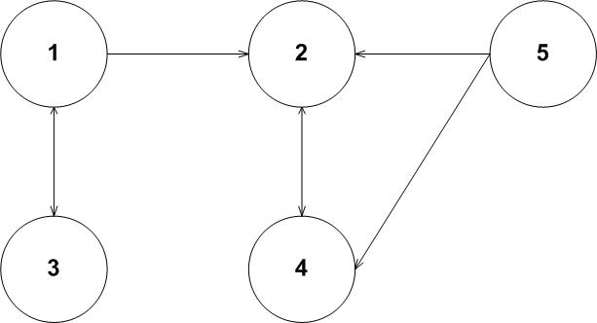
Recurrent
Recurrent : Start at State i, you have probability 1 of eventually returning to State i.
Notes:
https://www.uio.no/studier/emner/matnat/math/STK2130/v21/forelesningsnotater/lecture4.pdf
https://lancaster.ac.uk/~prendivs/accessible/math332/lec332.tex/Ch4.S5.html

Slide 10
Transient
Transient : A transient state is any state where this return probability is less than 1.
Notes:
https://www.uio.no/studier/emner/matnat/math/STK2130/v21/forelesningsnotater/lecture4.pdf
https://lancaster.ac.uk/~prendivs/accessible/math332/lec332.tex/Ch4.S5.html
Geometric Series: a+ar+ar²+ar³+⋯

Slide 11
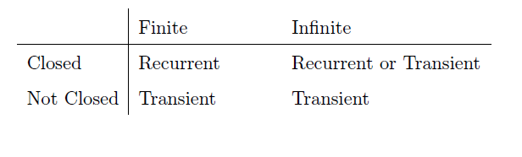
Finite and countably Infinite Markov Chains

Slide 12
Classification of States: example
1,3,5 are transient
A set is closed (C) if it is impossible to get out of it
C={2,4}
A set C is irreducible if i, j ЄC, i communicate with j
If C is a finite closed and irreducible set, then all sates in C are recurrent
{2, 4} is closed , irreducible and recurrent
Notes:
https://youtu.be/fa5Bdv_94ZE?si=98Awt-bIx5GQ5Coz
https://youtu.be/P20zFAfwbcY?si=llF6fox9i8Op5YUN

Slide 13
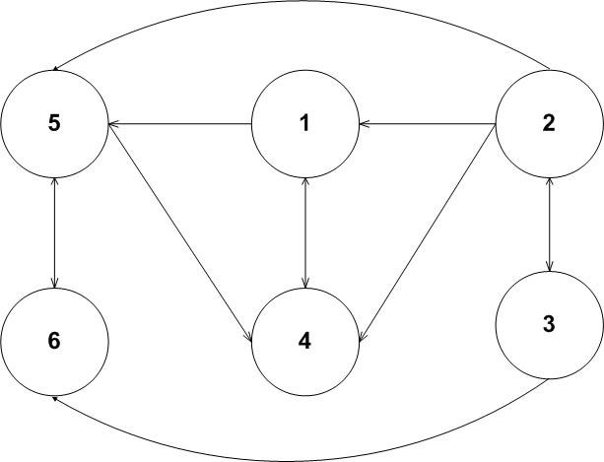
Classification of States: example
1, 3, 5 are transient
A set S is closed (C) if it is impossible to get out of it
A set C is irreducible if i, j ЄC, i communicate with j
C={1, 4, 5, 6}, closed and irreducible
If C is a finite closed and irreducible set, then C then all sates in C are recurrent
{1, 4, 5, 6} are recurrent
Notes:
https://youtu.be/Ymj-JmXl7qU?si=L_0SkVRh887Su9QP

Slide 14
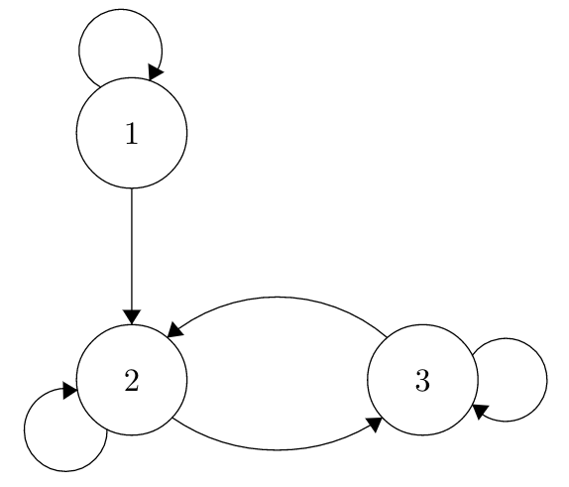
Irreducible vs. Reducible (chain characteristic)
Irreducible: Chains where it’s possible to go from any state to any other state.
It doesn’t matter if that path might take a long time, it just matters that it’s possible.
If a chain is irreducible, this implies that all states in the chain are recurrent.
Irreducible set: A set of states where every pair of states communicate.
Irreducible: {2,3}

Slide 15
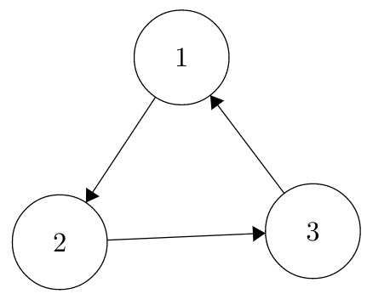
Period (state characteristic)
Each state in a Markov Chain has a period. The period is defined as the greatest common denominator of the number of steps it takes to return, given that you start in that state.
A sate of Markov chain is periodic if ∃ d > 1 such that only if n is a multiple of d.
From 2 → 3 → 1 → 2, return in 3 steps.
From 2 →2(directly) P₂₂=0, so not possible to return to 2 in a single step
To return again, go through the loop twice → 6 step
The chain returns to itself in exactly multiples of 3 steps (3, 6, 9, ...).
State 2: Can return to itself in 3, 6, 9, ... steps ⇒ period = gcd(3, 6, 9, ...) = 3
: in equation (1) stand for “such that”
Pii>0 means we will not consider any transition with probability≤0

Slide 16
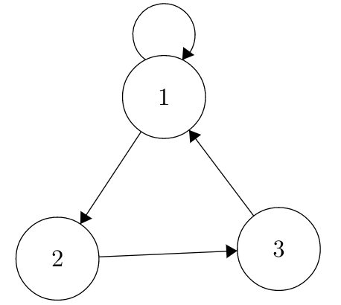
Period (state characteristic)
Each state in a Markov Chain has a period. The period is defined as the greatest common denominator of the length of return trips (i.e., number of steps it takes to return), given that you start in that state.
A sate of Markov chain is periodic if ∃ d > 1 such that only if n is a multiple of d.
State1: 1, ⇒ gcd =1
State2: possible return times = 3, 4, 5, 6, ... ⇒ gcd=1
State3: returns in 3, 4, 5, ... steps ⇒ gcd=1
d=1 and all the states are aperiodic

Slide 17
Aperiodic
If all states in a chain have period 1, that chain is aperiodic. Otherwise, it is a periodic chain.

Slide 18
Classification of States: example
Notes:
https://youtu.be/fa5Bdv_94ZE?si=98Awt-bIx5GQ5Coz
https://youtu.be/P20zFAfwbcY?si=llF6fox9i8Op5YUN

Slide 19
Supplementary readings: Expected number of visits
Let X_{n}​ be the state of the Markov chain at time n
Define the indicator of being in state iii at time n:
Then the total number of visits to state i, starting from i, is:
The expected number of visits is:
The expected value of an indicator variable is just the probability that the event happens:

Slide 20
Supplementary readings: Some basic definitions
: The probability the chain returns to state 1 for the first time at step n, given X₀=1

Slide 21
Supplementary readings: Some basic definitions
: Probability that the chain returns to state i (X₀=i) for the first time at step n.
: Total probability the chain ever returns to state i.
Notes:
"Ever returns" means: Is there any chance that the chain will return to state i at least once after time 0?
https://resing.win.tue.nl/isp/isp_01.pdf
https://www.hamilton.ie/ollie/Downloads/Mar1.pdf

